Slide 1
How to Write a Plot Twist Workshop
Here is where your presentation begins

Slide 2
Contents of this template
You can delete this slide when you’re done editing the presentation
Fonts | To view this template correctly in PowerPoint, download and install the fonts we used
Used and alternative resources | An assortment of graphic resources that are suitable for use in this presentation
Thanks slide | You must keep it so that proper credits for our design are given
Colors | All the colors used in this presentation
Icons and infographic resources | These can be used in the template, and their size and color can be edited
Editable presentation theme | You can edit the master slides easily. For more info, click here
For more info:
SLIDESGO | BLOG | FAQs
You can visit our sister projects:
FREEPIK | FLATICON | STORYSET | WEPIK | VIDEVO

Slide 3
Table of contents
01
Theory lesson
02
The topic
03
Tips
04
Practical exercise
You can describe the topic of the section here
You can describe the topic of the section here
You can describe the topic of the section here
You can describe the topic of the section here

Slide 4
01
Theory lesson
You can enter a subtitle here if you need it

Slide 5
Introduction
Mercury is the closest planet to the Sun and the smallest one in the entire Solar System. This planet's name has nothing to do with the liquid metal, since Mercury was named after the Roman messenger god. Mercury’s surface is filled with craters
Mercury takes a little more than 58 days to complete its rotation, so try to imagine how long days must be there! Since the temperatures are so extreme, albeit not as extreme as in Venus, Mercury has been deemed to be non-habitable for humans

Slide 6
—Someone Famous
“This is a quote, words full of wisdom that someone important said and can make the reader get inspired”

Slide 7
Concepts
Concept 1
Concept 2
Mercury is the closest planet to the Sun and the smallest one in the Solar System—it’s only a bit larger than the Moon
Venus has a beautiful name and is the second planet from the Sun. It’s hot and has a poisonous atmosphere

Slide 8
What is this topic about?
Definition
Importance
Impact
Mercury is the closest planet to the Sun and the smallest one of them all
Venus has a beautiful name and is the second planet from the Sun
Despite being red, Mars is actually a cold place. It’s full of iron oxide dust

Slide 9
Features of the topic
Intrigue
Impact
Despite being red, Mars is very cold
Neptune is the farthest planet from the Sun
Memorability
Relevance
Jupiter is the biggest planet of them all
Saturn is a gas giant and has several rings

Slide 10
Examples
Mystery
Science Fiction
Mars
The detective investigating a murder discovers that the seemingly innocent victim was the mastermind behind a series of crimes.
The entire world the characters have been living in turns out to be a simulated reality, and they must navigate the real world outside.
A character believed to be dead suddenly reappears, revealing that they faked their death to escape a dangerous situation.

Slide 11
Recommendations
Start early
Creative
Believable
Despite being red, Mars is very cold
Venus is the second planet from the Sun
Neptune is the farthest planet from the Sun
Don’t overuse
Test
Have fun
Mercury is the closest planet to the Sun
Saturn is a gas giant and has several rings
Jupiter is the biggest planet of them all

Slide 12
A picture always reinforces
the concept
You can give a brief description of the topic you want to talk about here. For example, if you want to talk about Mercury, you can say that it’s the smallest planet in the entire Solar System

Slide 13
4,498,300
Big numbers catch your audience’s attention

Slide 14
9h 55m 23s
333,000
386,000 km
Jupiter’s rotation period
The Sun’s mass compared to Earth’s
Distance between the Earth and the Moon

Slide 15
Awesome words

Slide 16
Practical exercise
Find out in which paragraph has the plot twist happened:
Sarah receives a mysterious antique painting that starts causing strange occurrences in her studio.
She discovers she is transported back in time to the era depicted in the painting and encounters her own ancestor.
Sarah realizes she is trapped in a family curse and must find a way to break free.
In this condensed version, the plot twist is still present in line 2, where Sarah discovers she has traveled back in time and encounters her own ancestor.

Slide 17
KWL (brainstorming)
What I know | Mercury is the closest planet to the Sun
 | Despite being red, Mars is a very cold planet
What I want to know | Venus is the second planet from the Sun
 | Jupiter is the biggest planet of them all
What I learned | Saturn is composed of hydrogen and helium
 | Neptune is the farthest planet from the Sun

Slide 18
Main topic and details
Surprise
Character-driven
Mercury is the closest planet to the Sun and the smallest of them all
Venus has a beautiful name and is the second planet from the Sun
Classification
Event-driven
Theme-based
Jupiter is a gas giant and the biggest planet in the Solar System
Despite being red, Mars is actually a cold place full of iron oxide dust

Slide 19
Common mistakes
Few clues
Mercury is the closest planet to the Sun
Incoherence
Venus has a very beautiful name, it’s very hot though
Mistakes
Predictability
Mars is actually a very cold place
Irrelevance
Jupiter is the biggest planet of them all

Slide 20
Sequence
Setup
Foreshadowing
Misdirection
Mercury is the closest planet to the Sun
Venus is the second planet from the Sun
Despite being red, Mars is actually a cold place
Development
Surprise
Impact
Jupiter is the biggest planet of them all
Saturn is composed of hydrogen and helium
Neptune is the farthest planet from the Sun

Slide 21
Classification
Surprise | Character driven | Event driven | Theme-based
Small Red Cold Rocky | Small Hot Dry Volcanic | Small Hot Rocky Cratered | Large Cold Gassy Striped
Mars is actually a very cold place | Venus has high temperatures | Mercury is the smallest planet | Jupiter is the biggest planet

Slide 22
Cause and effect
Problem | Lack of preparation | Predictability | Complexity
 | Mercury is the closest planet to the Sun | Mars is actually a very cold place | Saturn is a gas giant and has several rings
Solution | Planification | False clues | Simplify
 | Venus is the second planet from the Sun | Jupiter is the biggest planet of them all | Neptune is very farthest planet

Slide 23
Question and answer
Question
What are some key elements to consider when crafting a compelling plot twist?
Answer
Essential elements for a successful plot twist include foreshadowing, suspense, well-developed characters, believable motivations, and a fresh perspective that challenges the reader's assumptions for a lasting impact

Slide 24
Timeline
Mercury is the closest planet to the Sun and the smallest one in the Solar System
Venus has a beautiful name and is the second planet from the Sun. It’s terribly hot
Earth is the third planet from the Sun and the only one that harbors life in the Solar System
Despite being red, Mars is actually a cold place. It’s full of iron oxide dust

Slide 25
Parts and whole
The whole object
Parts of the object
What happens if the parts are missing?
Mercury is the closest planet to the Sun and the smallest one in the entire Solar System
Mercury
Venus has a beautiful name and is the second planet from the Sun. It’s hot and has a poisonous atmosphere
Mars
Saturn
What’s the function of the parts?
Venus
Saturn is a gas giant and has several rings. It’s mostly composed of hydrogen and helium
Jupiter

Slide 26
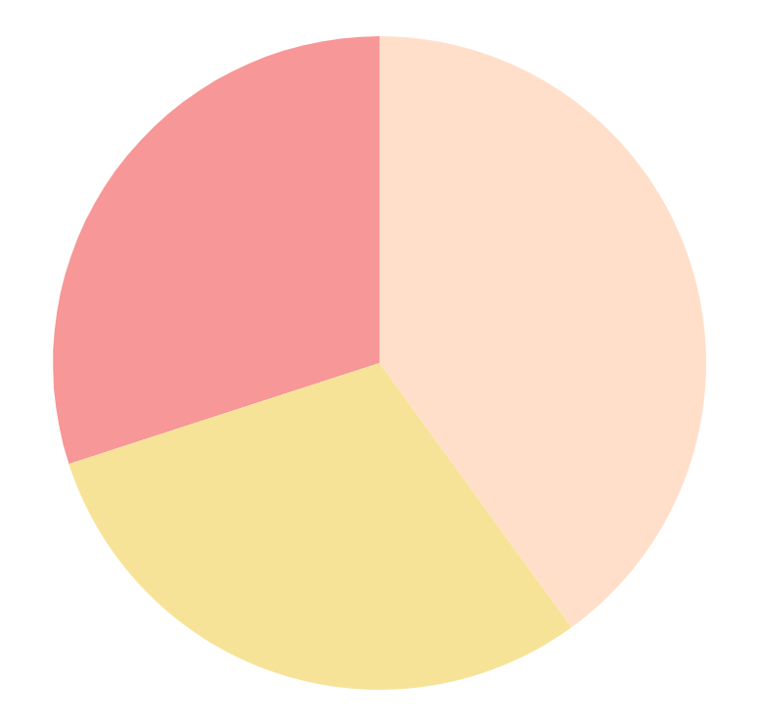
You can use this graph
40%
Plot twist
Mercury is the closest planet to the Sun and the smallest one
30%
Suspense
Venus has a beautiful name and is the second planet from the Sun
30%
Emotional impact
Mars is actually a cold place. It’s full of iron oxide dust
Follow the link in the graph to modify its data and then paste the new one here. For more info, click here

Slide 27
This is a map
Venus
Venus is the second planet from the Sun
Mercury
Mercury is the closest planet to the Sun
Mars
Despite being red, Mars is a very cold place

Slide 28
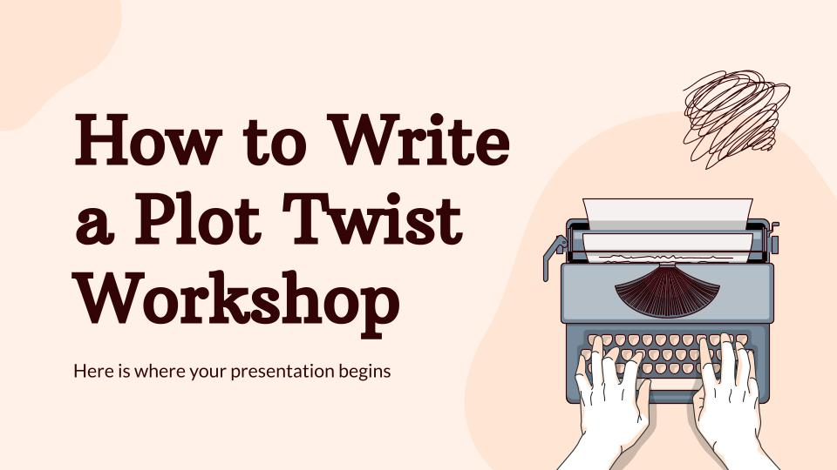
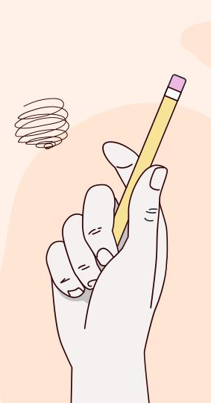
Mockups
You can replace the images on the screen with your own work. Just right-click on it and select “Replace images”

Slide 29
Thanks!
Do you have any questions?
youremail@freepik.com
+34 654 321 432
yourwebsite.com
Please keep this slide for attribution

